Slide 1
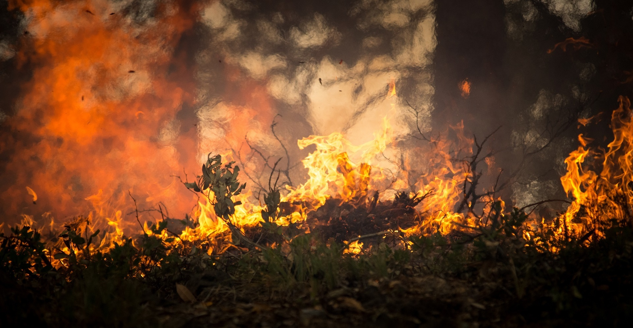
Project-one
An Analysis Sparked By Lightning

Slide 2
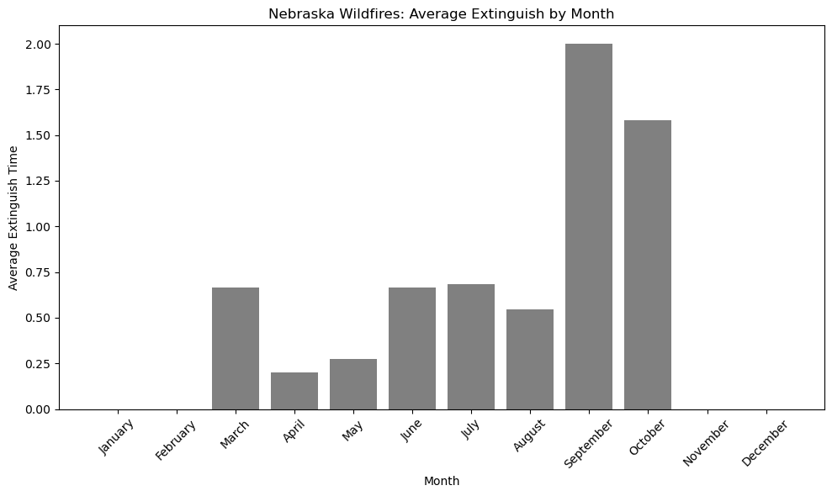
Has fire fighting gotten more efficient/ effective over time?
Yes, it has. Even though there are outliers over time fighting forest fires has gotten more efficient over time.

Slide 3
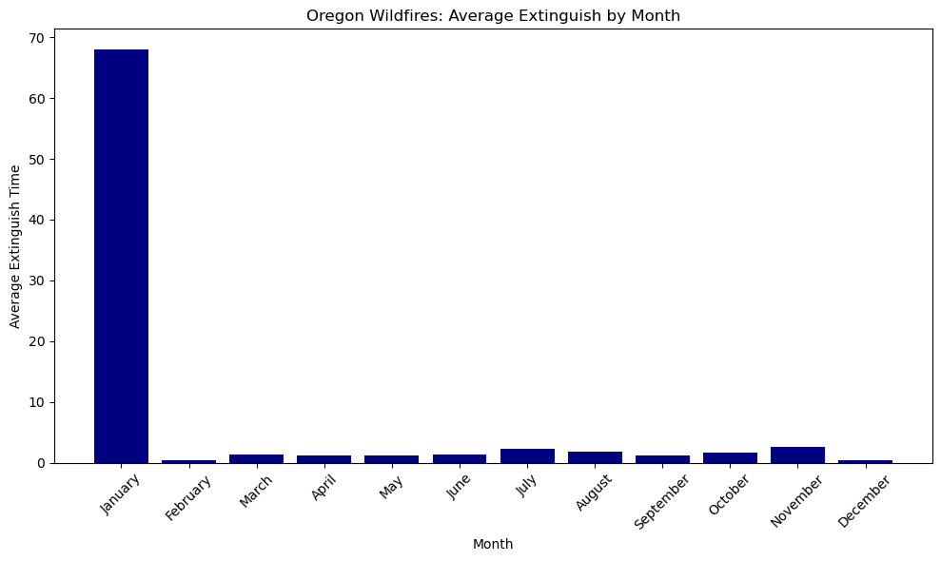
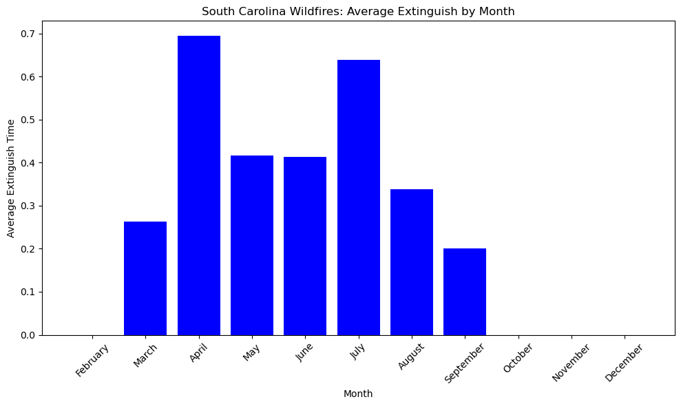
Major outlier for Oregon.
South Carolina mostly consistent and all under a day.

Slide 4
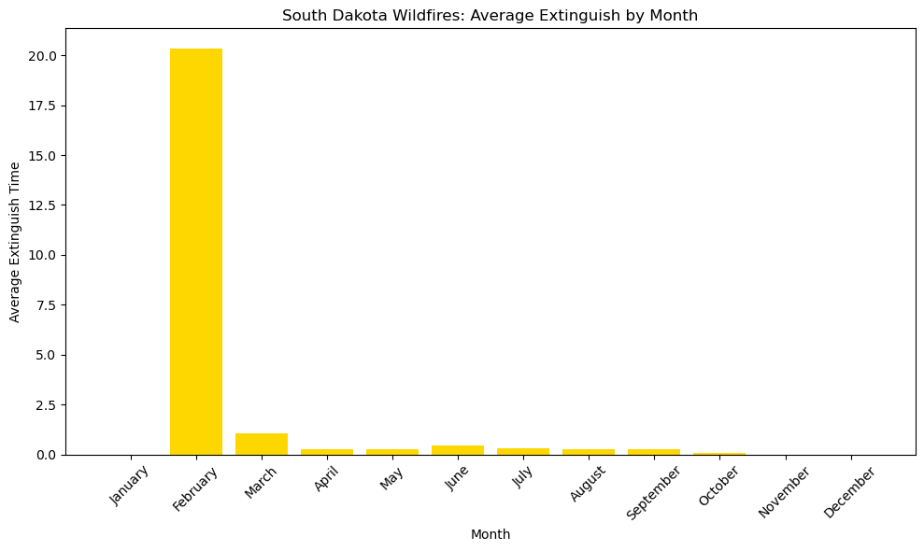
Another major outlier. The rest are 2.5 days or less

Slide 5
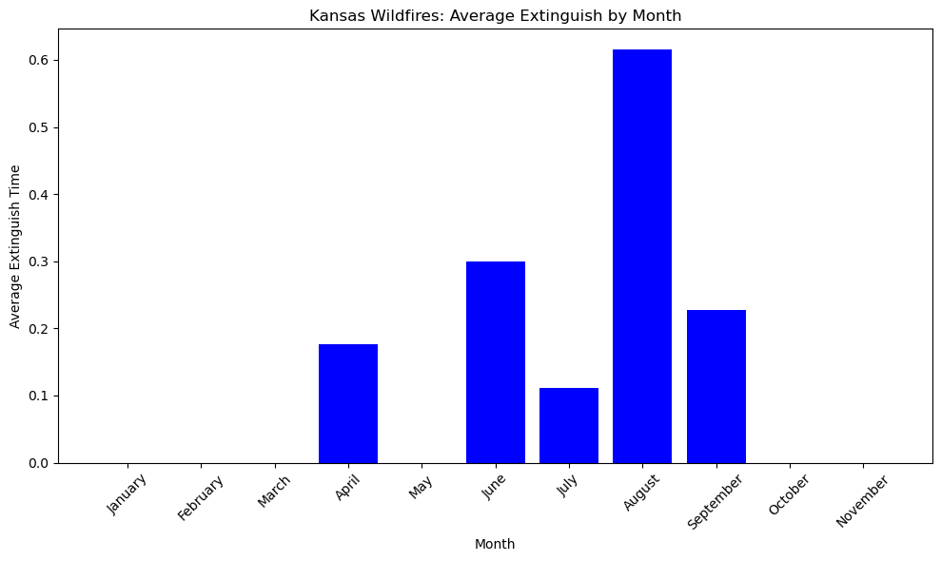
Kansas has been able to keep them under a day.

Slide 6
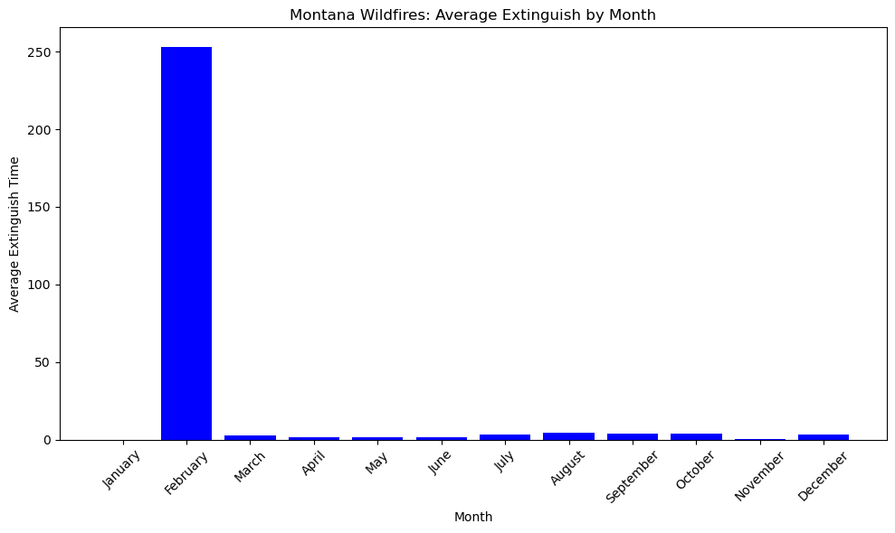
The only fire in February, causes this outlier.

Slide 7
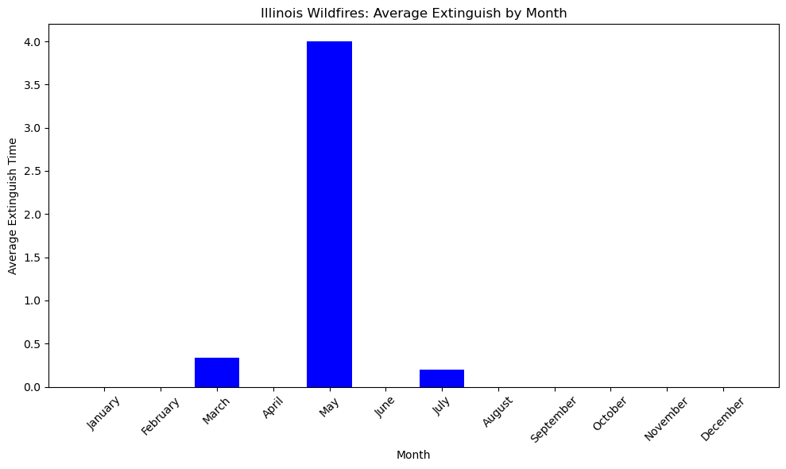
An outlier due to how few fires there are.

Slide 8
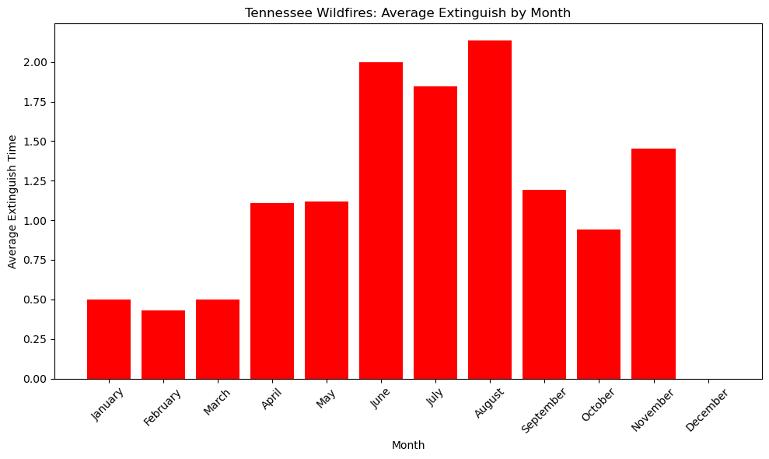
Fairly consistent. August is over 2 days. June just under.

